Slide 1
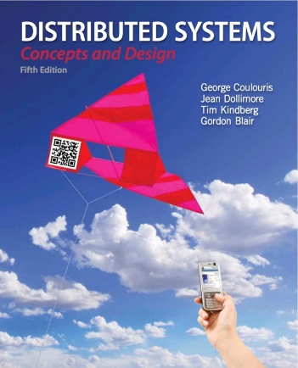
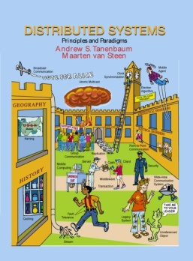
Distributed System Models
Dr. Rajkumar Buyya
Cloud Computing and Distributed Systems (CLOUDS) Laboratory
Department of Computing and Information Systems
The University of Melbourne, Australia
http://www.cloudbus.org/652
Most concepts are
drawn from Chapter 2
© Pearson Education
Some ideas from Chapter 1
© Pearson Education

Slide 2
Presentation Outline
Introduction
Physical Models:
  Three Generations of DS: Early, Internet-Scale, Contemporary
Architectural Models
  Software Layers
  System Architectures
    Client-Server
      Clients and a Single Server, Multiple Servers, Proxy Servers with Caches, Peer Model
    Alternative Client-Sever models driven by:
      Mobile code, mobile agents, network computers, thin clients, mobile devices, and spontaneous networking
    Design Challenges/Requirements
Fundamental Models – formal description
  Interaction, failure, and security models.
Summary
Notes:
System architectures - depends on the specific application
What is the best way to separate and place the parts of a distributed system at the software and system level?
Many models are drive by unique characteristics of participants, such as mobile, remote and ad-hoc users
The design of interaction, failure and security will depend on app. dom.

Slide 3
Introduction
  Distributed systems should be designed to function correctly in ALL circumstances/scenarios.
  Distributed system models helps in…
    ..classifying and understanding different implementations
    ..identifying their weaknesses and their strengths
    ..crafting new systems outs of pre-validated building blocks
  We will study distributed system models from different perspectives
    Structure, organization, and placement of components
    Interactions
    Fundamental properties of systems

Slide 4
Characterization
  The structure and the organization of systems and the relationship among their components should be designed with the following goals in mind:
    To cover the widest possible range of circumstances.
    To cope with possible difficulties and threats.
    To meet the current and possibly the future demands.
  Architectural models provide both:
    a pragmatic starting point
    a conceptual view
  to address these challenges.
In terms of implementation models and basic blocks
In terms of logical view of the system, interaction flow, and components

Slide 5

Characterization: Challenges (Difficulties and Threats)
    Widely varying models of use
      High variation of workload, partial disconnection of components, or poor connection.
    Wide range of system environments
      Heterogeneous hardware, operating systems, network, and performance.
    Internal problems
      Non synchronized clocks, conflicting updates, various hardware and software failures.
    External threats
      Attacks on data integrity, secrecy, and denial of service.

Slide 6
Characterization: Dealing with Challenges
    Widely varying models of use
      The structure and the organization of systems allow for distribution of workloads, redundant services, and high availability.
    Wide range of system environments
      A flexible and modular structure allows for implementing different solutions for different hardware, OS, and networks.
    Internal problems
      The relationship between components and the patterns of interaction can resolve concurrency issues, while structure and organization of component can support failover mechanisms.
    External threats
      Security has to be built into the infrastructure and it is fundamental for shaping the relationship between components.

Slide 7
Models at a Glance
Physical, Architectural, and Fundamental Models

Slide 8
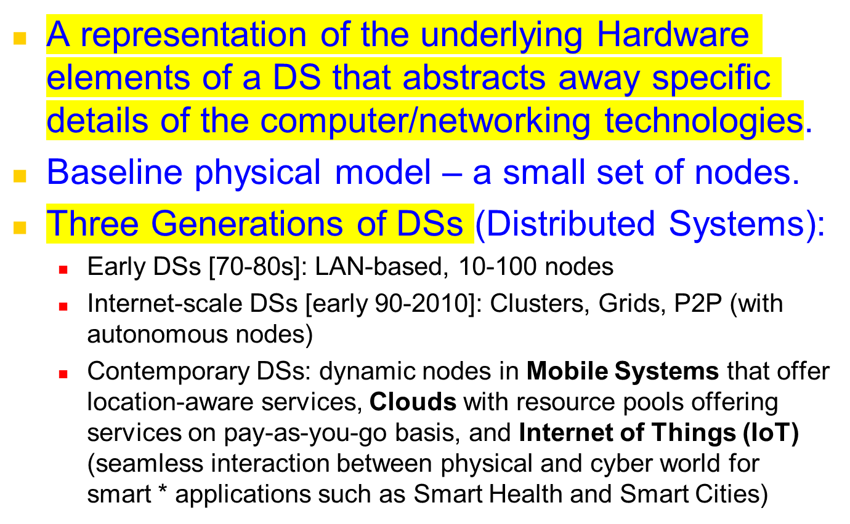
Physical Models

Slide 9
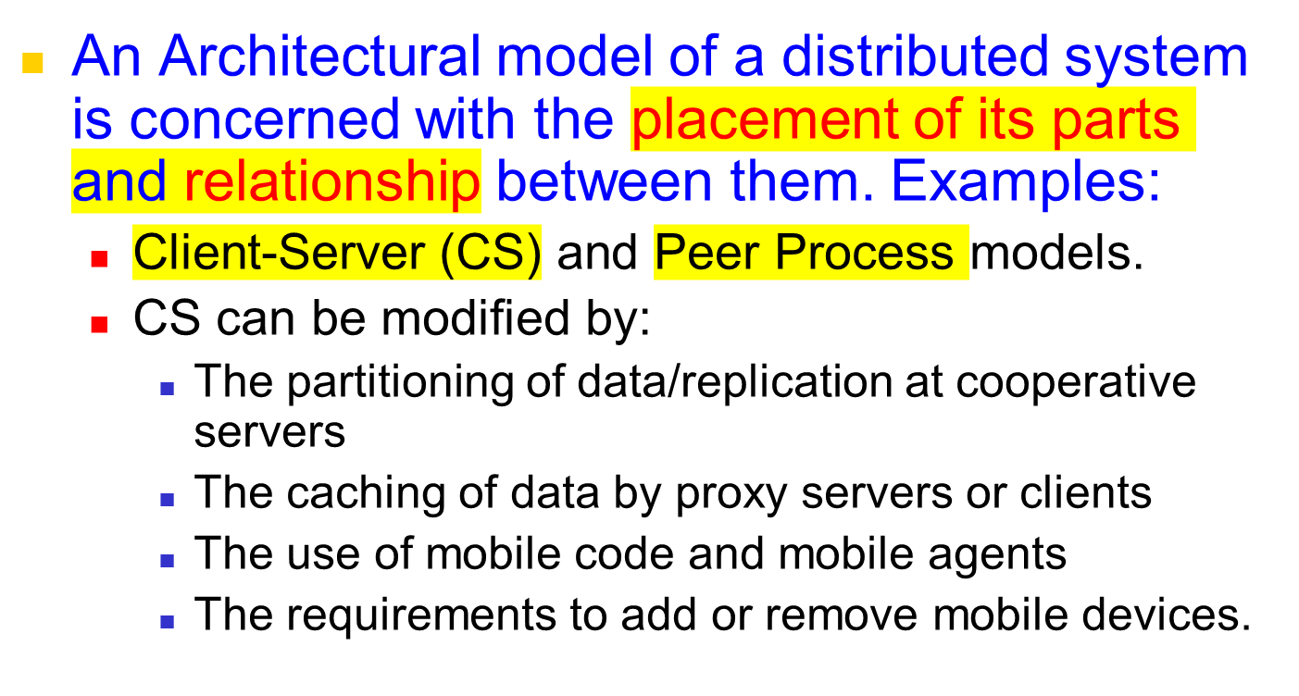
Architectural model
Notes:
Model used is dictated solely by the application domain and the user needs
Data can be partitioned or replicated amongst many cooperative servers for performance and reliability reasons
Data can be cached by proxy servers at lower levels (I.e. ISP, local exchange) or at the client itself to improve performance and resilience to transient network congestion or failure
Mobile code can be downloaded from server and executed on client, reducing strain on server (Java Applets)

Slide 10
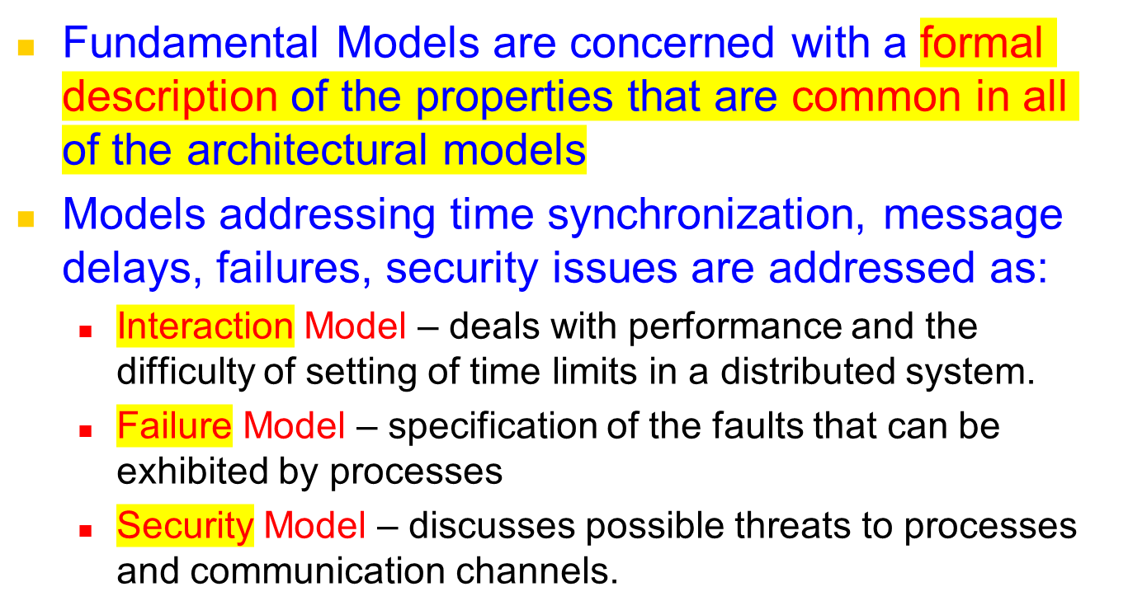
Fundamental Models
Notes:
There are 3 core models that describe the common properties of all the architectural models:
Interaction model: Should describe all appropriate client-server interactions including unusual cases
Failure model: Failures can occur at many levels (physical, transport, os, middleware, application). Correct and incorrect operation needs to be rapidly identified
Secure model: Threats can occur at many levels, on the wire, from malicious users, compromised servers. Need to be aware!

Slide 11
Presentation Outline
Introduction
Architectural Models
  Software Layers
  System Architectures
    Client-Server
      Clients and a Single Sever, Multiple Servers, Proxy Servers with Caches, Peer Model
    Alternative Client-Sever models driven by:
      Mobile code, mobile agents, network computers, thin clients, mobile devices and spontaneous networking
    Design Challenges/Requirements
Fundamental Models – formal description
  Interaction, Failure, and Security models.
Summary

Slide 12
Architectural Models – Intro [1]
The architecture of a system is its structure in terms of separately specified components.
  Its goal is to meet present and likely future demands.
  Major concerns are making the system reliable, manageable, adaptable, and cost-effective.
Architectural Model:
  Simplifies and abstracts the functions of individual components
  The placement of the components across a network of computers – define patterns for the distribution of data and workloads
  The interrelationship between the components – ie., functional roles and the patterns of communication between them.
Notes:
Goal: Forward looking. Design choices need to be made considering future demand. What might suit 10 users is terrible for 10,000 users. RELATE TO ASSIGNMENT/Dictionary design!!! Reliability/maintainability is crucial (e.g. need to add feature)
Using a well defined and well chosen architectural model can help in this respect!!
By abstracting and componentizing our model, we can enable it to be distributed and “scaled-out” based on changing needs

Slide 13


Architectural Models – Intro [2]
Architectural Model - simplifies and abstracts the functions of individual components:
  An initial simplification is achieved by classifying processes as:
    Server processes
    Client processes
    Peer processes
      Cooperate and communicate in a symmetric manner to perform a task.
client
server
peer
peer
Notes:
At a high level we can look at the application and user requirements, and classify the individual processes and logic as Server, Client or Peer processes. Take the Dictionary server as an example. We could have had one monolithic application, will all words and interface available locally.
However a client-server approach may be more efficient. Previous queries could be cached locally. Word additions, removes and modifications can be done centrally. C/S is valid approach!
Could use a peer model were each peer has a segment of Dictionary

Slide 14
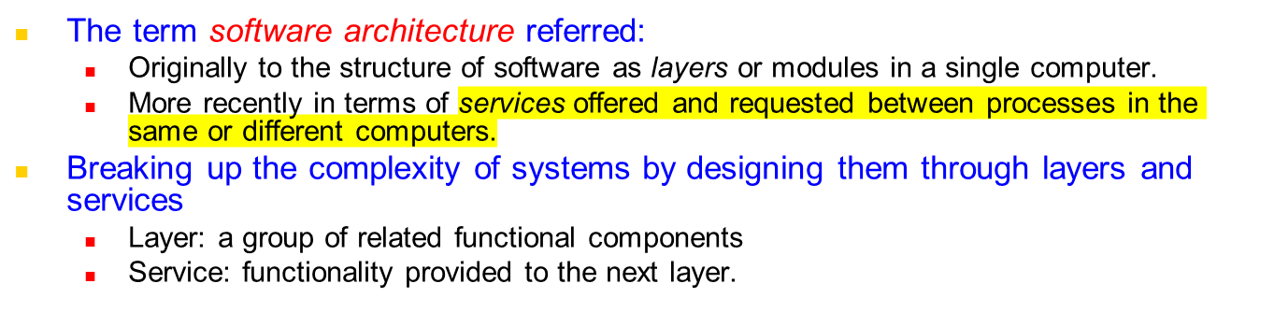
Software Architecture and Layers
Layer N
…
Layer 2
(services offered to above layer)
Layer 1
Notes:
Layers exist in the “stack” at both a single machine and between multiple machines
Operating systems typically split functionality into layers, and hide the complexity of many common operations from users and programmers.
Layers access levels above and below them as “services”

Slide 15
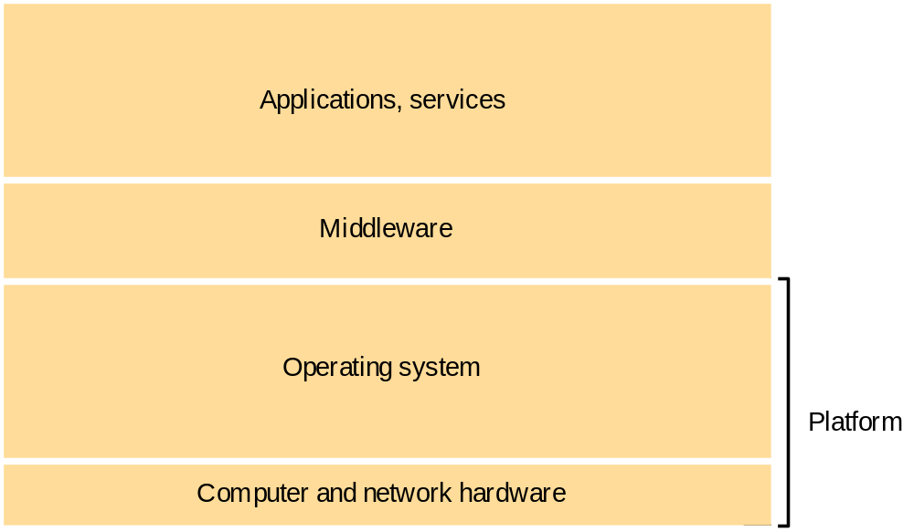
Software and hardware service layers in distributed systems
Notes:
A networked computer operating system is a perfect example of this layering
User’s interact with applications and services using the GUI or CLI
Applications and services depend on middleware and OS functions to do anything useful (RPC/RMI/TCP+IP)
Middleware/OS access the hardware and network links directly to send and receive information

Slide 16
Platform
The lowest hardware and software layers are often referred to as a platform for distributed systems and applications.
These low-level layers provide services to the layers above them, which are implemented independently in each computer.
Major Examples
    Intel x86/Windows
    Intel x86/Linux
    Intel x86/Solaris
    PowerPC/MacOS
    iPhone/iOS
    Samsung Galaxy/Android
Notes:
Even thought these platforms are reasonably disparate (Unix, Windows) & (x86, PPC, SPARC) they still have a core set of services and middleware in common. This is essential to enable these platforms to communicate, interoperate and collaborate together with minimal effort.
We don’t want to be converting between little endian/big endian or have to care about the specifics of each platform at the higher level

Slide 17
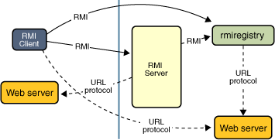
Middleware
A layer of software whose purpose is to mask heterogeneity present in distributed systems and to provide a convenient programming model to application developers.
Major Examples:
    Sun RPC (Remote Procedure Call)
    OMG CORBA (Common Object Request Broker Architecture)
    Microsoft D-COM (Distributed Components Object Model)
    Sun Java RMI (Remote Method Invocation)
    Microsoft .NET
    Modern Middleware Examples:
      Manjrasoft Aneka– for Cloud computing
      Sun/Oracle J2EE
      IBM WebSphere
      Google AppEngine
      Microsoft Azure
      SAP Integration Suite
Notes:
To enable us to be truly platform agnostic, we need a core set of middleware and functions that we can use on all platforms
Sun RPC is available on most Unix platforms
CORBA is a distributed middleware that is available for all major platforms
Java RMI is available on any platform there is a compliant JVM install
.NET is becoming a standard, and is available for Windows/Linux/MacOS
Higher level middleware (Gridbus/Globus) can hide even more complexity

Slide 18
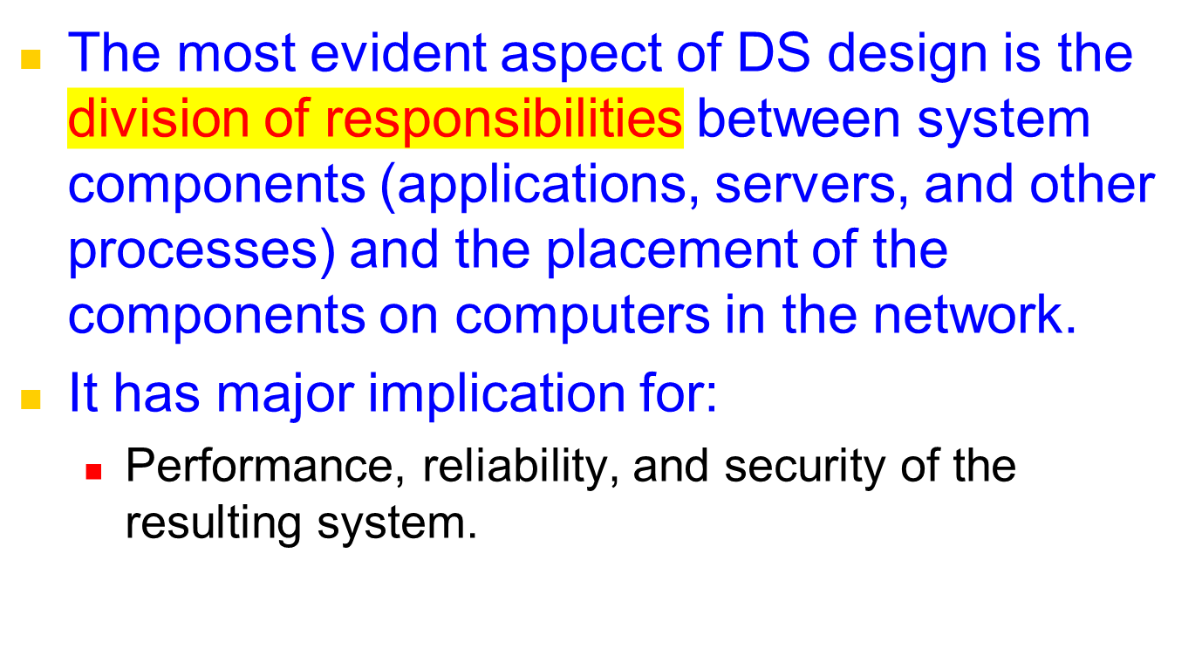
System Architecture
Notes:
The decisions that you make as system designers is crucial [tradeoffs]
Moving some load to client (e.g. applet execution) can improve response and allow SOME disconn. access, but can be a security risk.
Moving complexity on server can reduce client requirements and lower the entry bar (e.g. server based CGI/PHP, client only needs browser)
TRADEOFFS!!!

Slide 19
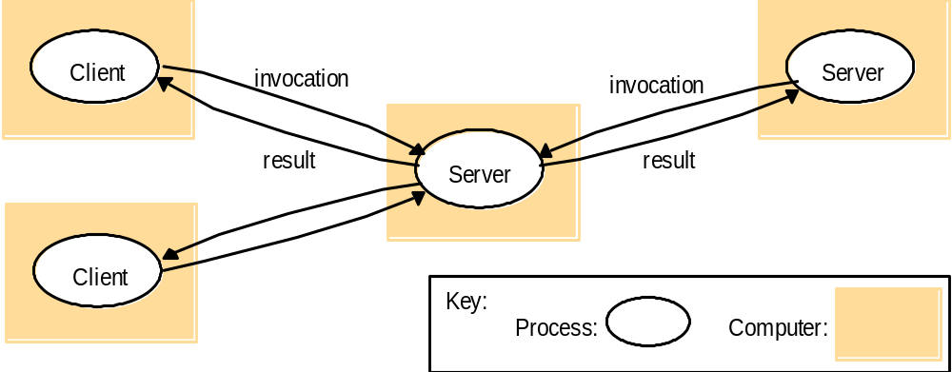
Client-Server Basic Model:
Clients invoke individual servers
Client processes interact with individual server processes in a separate computer in order to access data or resource. The server in turn may use services of other servers.
Example:
  A Web Server is often a client of file server.
  Browser → search engine -> crawlers → other web servers.
Notes:
Querying a web server, which could then query a mysql or oracle database before returning the content of a page
Web server is a client of the database server
A search engine, as well as serving search requests from clients, crawls other websites to keep its information current.
Search engine is both a server and a client for other web servers.

Slide 20






Client-Server Architecture Types
(Tier arch compliments layer architecture)
    Two-tier model (classic)
    Three-tier (when the server, becomes a client)
    Multi-tier (cascade model)
client
server
client
Server/client
server
server
client
Server/client
Server/client
server

Slide 21
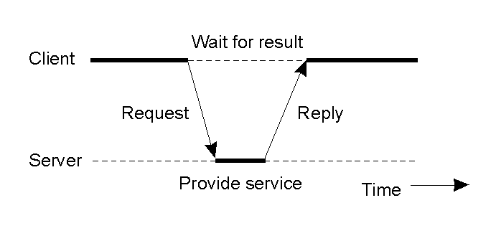
Clients and Servers
General interaction between a client and a server.
Notes:
This is a typical interaction for a single threaded, monolithic client. A client requests some processing or information from a server that it needs. It waits in a blocking fashion for the reply containing the result, then it can proceed with it’s execution.

Slide 22
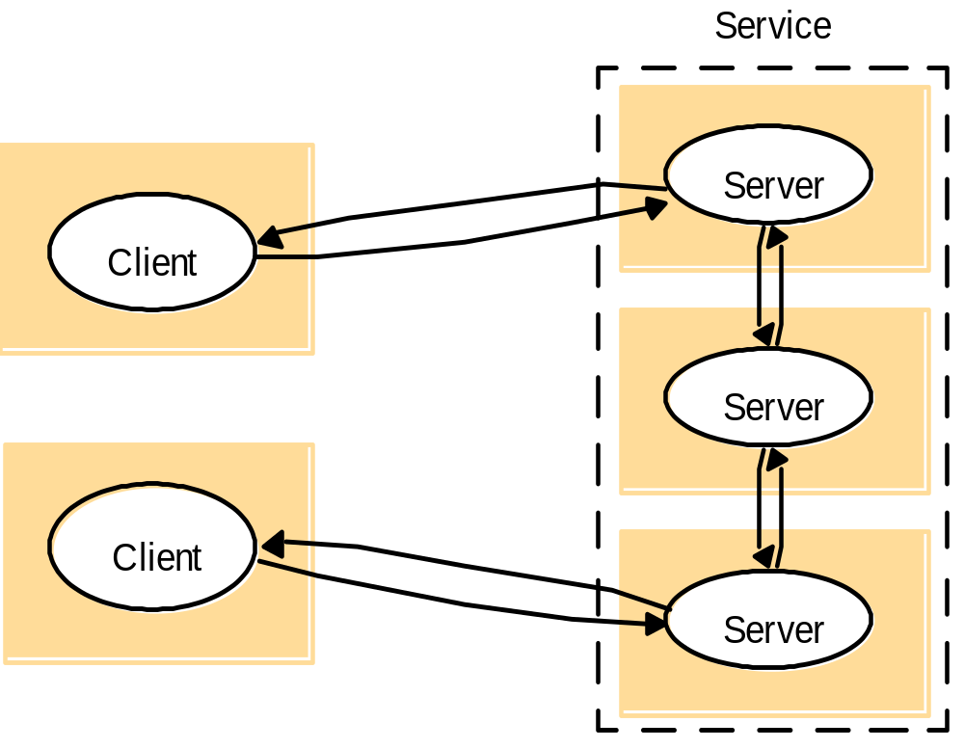
A service provided by multiple servers
Services may be implemented as several server processes in separate host computers.
Example: Cluster based Web servers and apps such as Google, parallel databases Oracle
Notes:
This topology is extremely common. A web site like google serves approximately 100M searches a day.
It is obviously simply not feasible to serve them from a single server.
Google uses clusters containing 10’s of thousands of machines offering equivalent services, and you are redirected (via DNS and other means) to one of them. Can also be redirected at protocol or application level.
Similar techniques can be used for Oracle databases, that are replicated over many servers to offer redundancy and performance

Slide 23
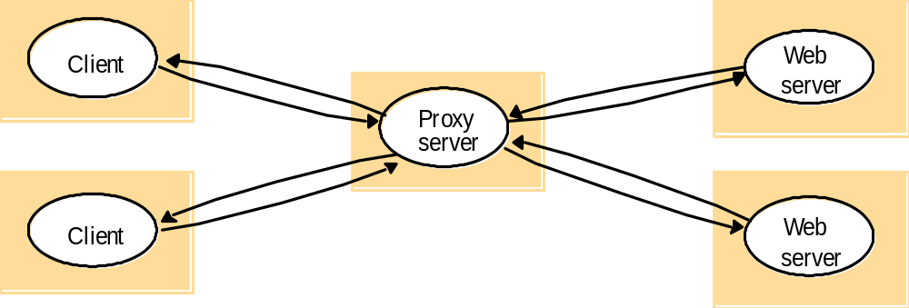
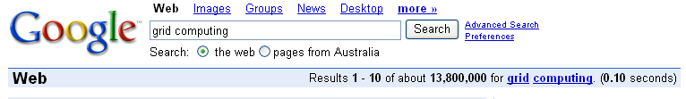
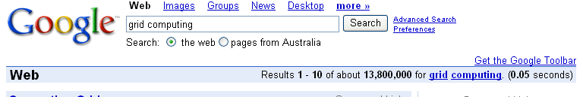
Proxy servers (replication transparency) and caches: Web proxy server
A cache is a store of recently used data.
Notes:
Web proxy servers can operate at client level, at ISP level and at edge/gateway levels to improve performance and reduce communication costs for frequently accessed data.
Caching can even be used for dynamic data (such as a google search). This reduces the load on the web servers and improves the performance for end users by reducing the time taken for a dynamic request. Google uses this technique extensively! When serving 100M requests/day this saves resources.

Slide 24
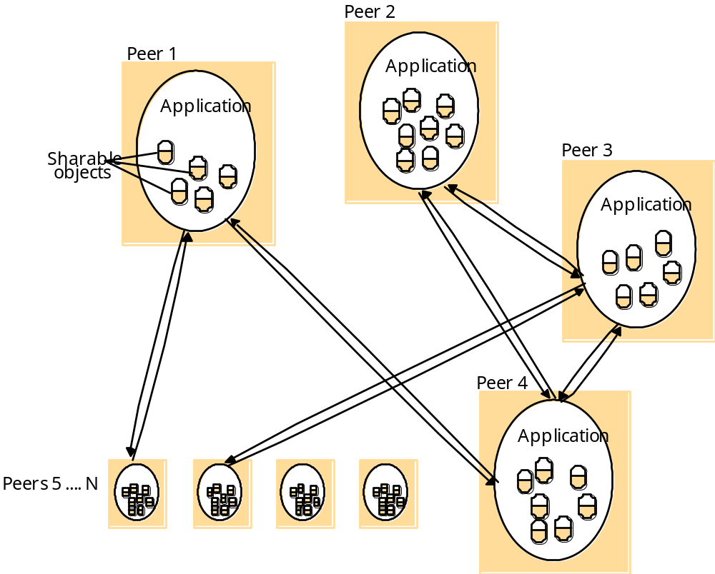
Peer Processes: A distributed application based on peer processes
All of the processes play similar roles, interacting cooperatively as peers to perform distributed activities or computations without distinction between clients and servers. E.g., music sharing systems Napster, Gnutella, Kaza, BitTorrent.
Distributed “white board” – users on several computers to view and interactively modify a picture between them.
Notes:
Peer model suits ad-hoc groupings of participants. Can be used very effectively… for instant bittorrent “swarm” style downloaded.
-No central point of failure (reliable)
-No central point of control (difficult to deny service for adversaries)
-Some peers will typically contribute more than others (I.e. seed or super-peer)

Slide 25

P2P with a Centralized Index Server
(e.g. Napster Architecture)
peer
peer
peer
peer
peer
peer
peer

Slide 26
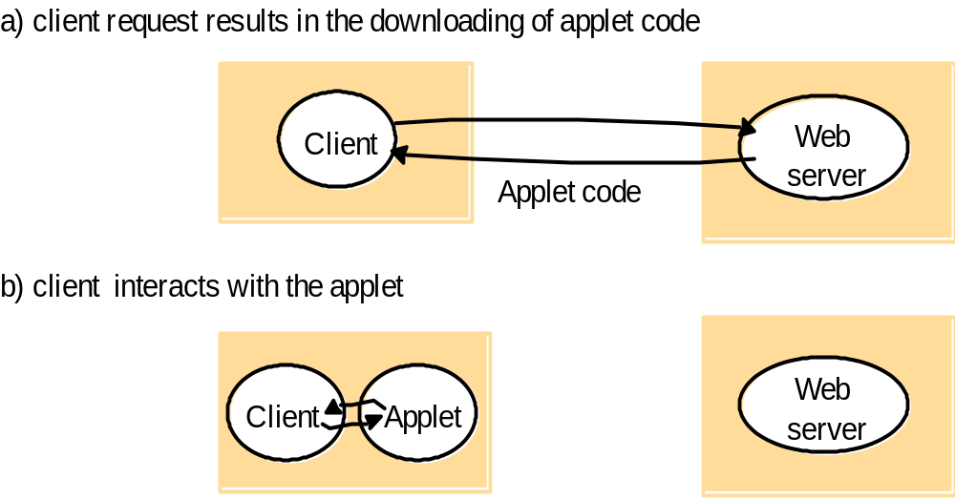
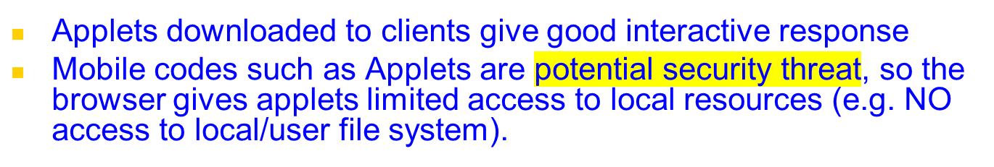
Variants of Client Sever Model: Mobile code and Web applets
Notes:
Similar to client-server model but client takes on more responsibility
As code is executed locally the application has good responsiveness.
Need to be careful running such code as client can be exploited. From a server perspective, they cannot control the client environment so there are integrity issues there as well (e.g. client applet not suitable for online banking!)

Slide 27
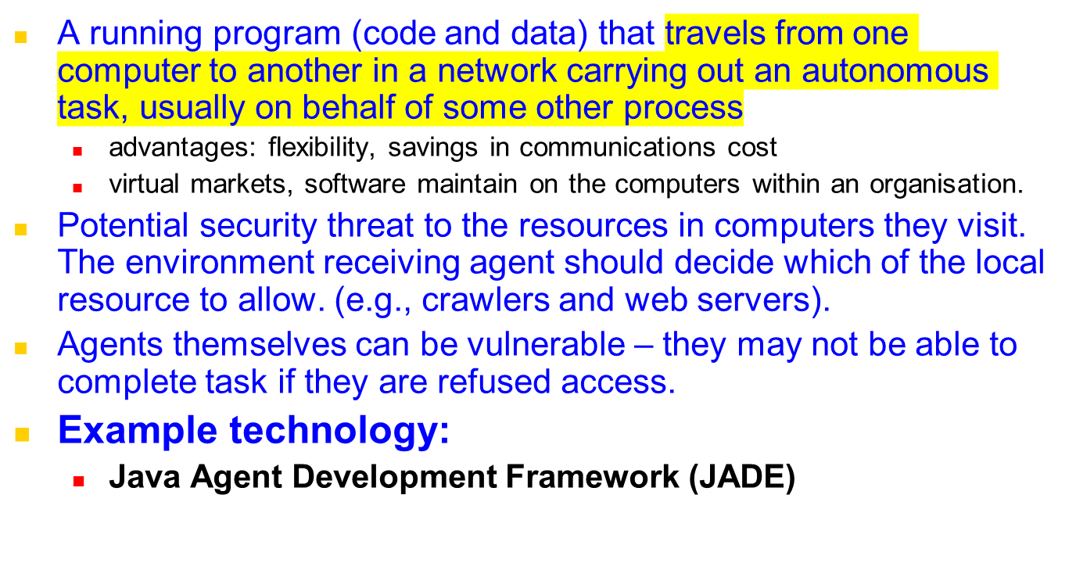
Variants of Client Sever Model: Mobile Agents
Notes:
Can be a useful approach (e.g. data indexing/mining) if data is spread over wide geographical areas.
Bring application (which is small) to data rather than the other way around.

Slide 28
Thin clients and compute servers
Compute server
Network computer or PC
Thin
network
Application
Client
Process
Network computer: download OS and applications from the network and run on a desktop (solve up-gradation problem) at runtime.
Thin clients: Windows-based UI on the user machine and application execution on a remote computer. E.g, X-11 system.
Notes:
Network computer: Citrix Application Server does this, loading applications over network as needed to run on local desktop
Thin clients: X11 (Unix), RDC/Terminal Services (Windows), VNC (Unix/Windows) “Presentation Server” approach
Sends raster of desktop image, user clicks and keyboard entries are sent to remote server.
Centralised infrastructure is easy to maintain and secure(eg keep antivirus and patches up to date centrally)!

Slide 29
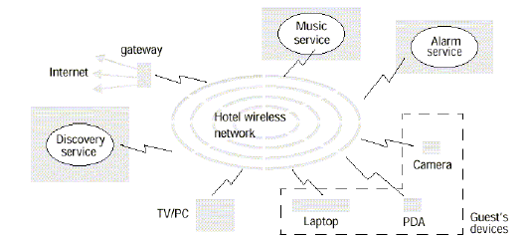
Mobile devices and spontaneous networking
[3rd Generation Distributed System]
The world is increasingly populated by small and portable computing devices.
W-LAN needs to handle constantly changing heterogeneous, roaming devices
Need to provide discovery services: (1) registration service to enable servers to publish their services and (2) lookup service to allow clients to discover services that meet their requirements.
Notes:
Need common standards!
e.g My phone can list all available wireless networks. I can join one (that I am permitted) and receive an IP via DHCP.
Emerging standards such as bonjour broadcast to nearby computers to advertise resources and peripherals available, such as printers, music collections, web sites, ftp sites, video conferencing services
Standards such as UPnP AV allow many devices to converse already - this is not hypothetical. Some Nokia phones support this ---> TV/STB

Slide 30
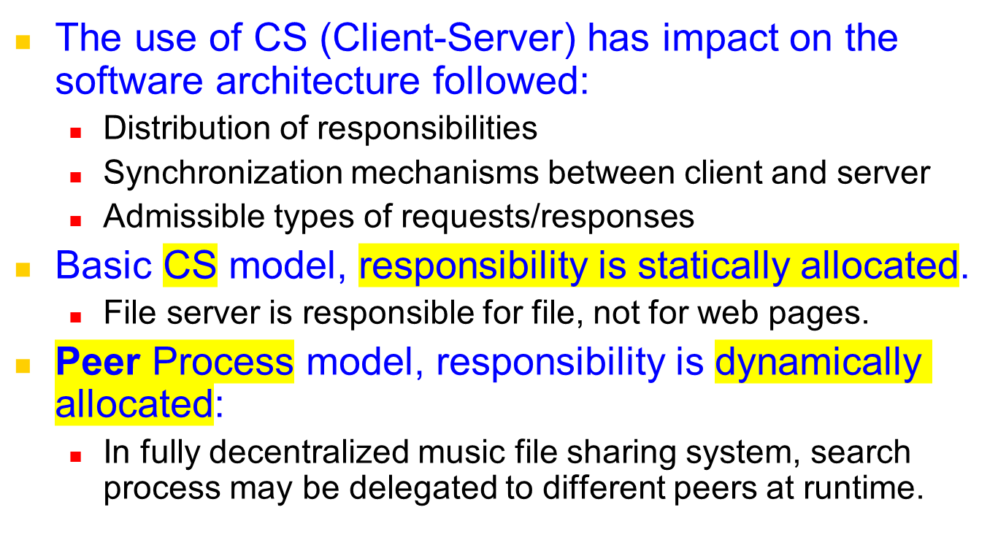
Summary - Models and Implications
Notes:
Client server paradigm has changed the way we design software and services.
Basic Client/Server model, each participant performs well defined and predictable functions
Peer model, clients can be servers, servers can be clients, any participant can query another.

Slide 31
Design Requirements/Challenges of Distributed Systems
Performance Issues
  Responsiveness
    Support interactive clients
      Use caching and replication
  Throughput
  Load balancing and timeliness
Quality of Service:
  Reliability
  Security
  Adaptive performance.
Dependability issues:
  Correctness, security, and fault tolerance
  Dependable applications continue to work in the presence of faults in hardware, software, and networks.
Notes:
Mirrored (replicated services) and caching can improve reliability, throughput and scalability more than a single server approach
To ensure our replicated cluster is not unbalanced we can rebalance via DNS redirection, process migration
QoS is becoming increasing important (and expected) by clients as more and more of our daily functions is served online
Dependability depends on the application domain. What we will tolerate when accessing a website is not same as aviation.

Slide 32
Presentation Outline
Introduction
Architectural Models
  Software Layers
  System Architectures
    Client-Server
      Clients and a Single Sever, Multiple Servers, Proxy Servers with Caches, Peer Model
    Alternative Client-Sever models driven by:
      Mobile code, mobile agents, network computers, thin clients, mobile devices and spontaneous networking
    Design Challenges/Requirements
Fundamental Models – formal description
  Interaction, Failure, and Security models.
Summary

Slide 33
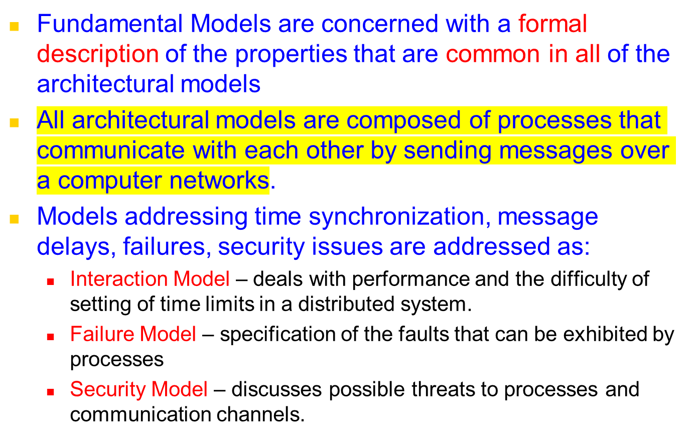
Fundamental Models at Glance
Notes:
There are 3 core models that describe the common properties of all the architectural models:
Interaction model: Should describe all appropriate client-server interactions including unusual cases
Failure model: Failures can occur at many levels (physical, transport, os, middleware, application). Correct and incorrect operation needs to be rapidly identified
Secure model: Threats can occur at many levels, on the wire, from malicious users, compromised servers. Need to be aware!

Slide 34
Interaction Model
Computation occurs within processes;
The processes interact by passing messages, resulting in:
  Communication (information flow)
  Coordination (synchronization and ordering of activities) between processes.
Two significant factors affecting interacting processes in a distributed system are:
  Communication performance is often a limiting characteristic.
  It is impossible to maintain a single global notion of time.
Notes:
What functions do each of our processes perform (client/server/peer). What are the function steps? Can they be captured by a local or distributed algorithm??
Is there significant comms or coordination between processes or are they independent (e.g. database vs. file mirror)
Coordinated behaviors is difficult in light of non synchronized clocks over distributed systems [we will address later]

Slide 35
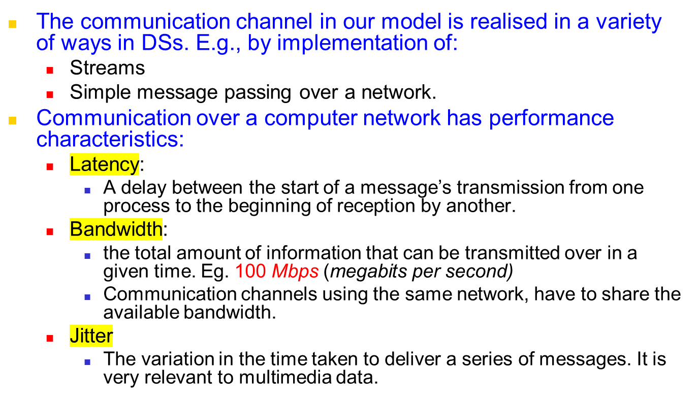
Interaction Model:
Performance of Communication Channel
Notes:
Communication can be discrete messages or packets, or constant streams/broadcasts (e.g. satellite or sensor data).
We need to define the network characteristics of the participants (client/server) and adjust our expectations accordingly.
LAN: We might wait 1-2 seconds at most for an acknowledgement for our packet before deciding there is a problem
SAT: We might wait 22 minutes at most for an acknowledgement for our packet before deciding there is a problem (MARS)
The availability of bandwidth and the contention on the link will also influence the types of interactions that occur
JITTER is crucial for real-time applications such as video/audio streaming, or avionics

Slide 36
Interaction Model:
Computer clocks and timing events
Each computer in a DS has its own internal clock, which can be used by local processes to obtain the value of the current time.
Therefore, two processes running on different computers can associate timestamp with their events.
However, even if two processes read their clocks at the same time, their local clocks may supply different time.
  This is because computer clock drifts from perfect time and their drift rates differ from one another.
Even if the clocks on all the computers in a DS are set to the same time initially, their clocks would eventually vary quite significantly unless corrections are applied.
  There are several techniques to correct time on computer clocks. For example, computers may use radio receivers to get readings from GPS (Global Positioning System) with an accuracy about 1 microsecond.
Notes:
Drift can be countered somewhat with use of Network Time Protocol to get accuracy within a second
GPS assistance can enable us to get clock readings accurate within 1 microsecond

Slide 37
Interaction Model:
Two variants of the interaction model
In a DS it is hard to set time limits on the time taken for process execution, message delivery or clock drift.
Synchronous DS – hard to achieve:
  The time taken to execute a step of a process has known lower and upper bounds.
  Each message transmitted over a channel is received within a known bounded time.
  Each process has a local clock whose drift rate from real time has known bound.
Asynchronous DS: There is NO bounds on:
  Process execution speeds
  Message transmission delays
  Clock drift rates.
Notes:
Synch: A type of two-way communication with virtually no time delay, allowing participants to respond in real time.
Regularly occurring events in timed intervals are kept in step using some form of electronic clocking mechanism.
Synchronous distributed systems are hard to achieve (especially over the internet) do to their unpredictable nature
Asynch: A type of two-way communication that occurs with a time delay, allowing participants to respond at their own convenience.

Slide 38
Interaction Model:
Event Ordering
In many DS applications we are interested in knowing whether an event occurred before, after, or concurrently with another event at other processes.
  The execution of a system can be described in terms of events and their ordering despite the lack of accurate clocks.
Consider a mailing list with:
users X, Y, Z, and A.
Notes:
Ideally every event would be precisely (and consistently) time-stamped but we cannot guarantee that!

Slide 39
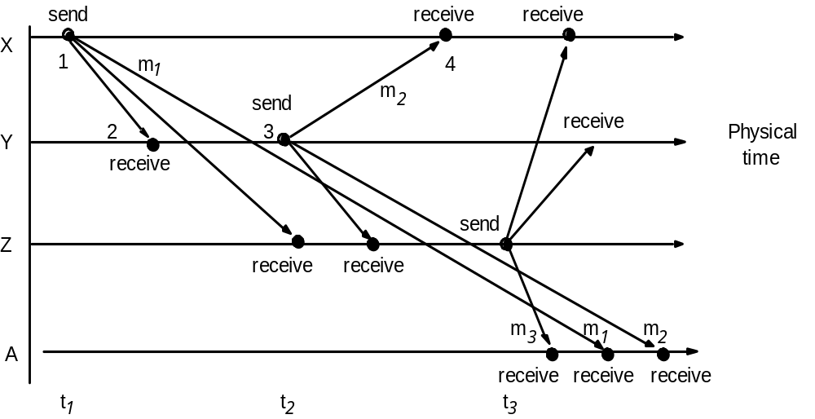
Real-time ordering of events
Notes:
X sees m1, m2, m3
Y sees m1, m2, m3
Z sees m1, m2, m3
A sees m3, m1, m2 [If they are timestamped in approx order, they can be reordered, or alternatively we can infer using logic “RE”]

Slide 40
Inbox of User A looks like:
Item | From | Subject
23 | Z | Re: Meeting
24 | X | Meeting
26 | Y | Re: Meeting
Due to independent delivery in message delivery, message may be delivered in different order.
If messages m1, m2, m3 carry their time t1, t2, t3, then they can be displayed to users accordingly to their time ordering.

Slide 41
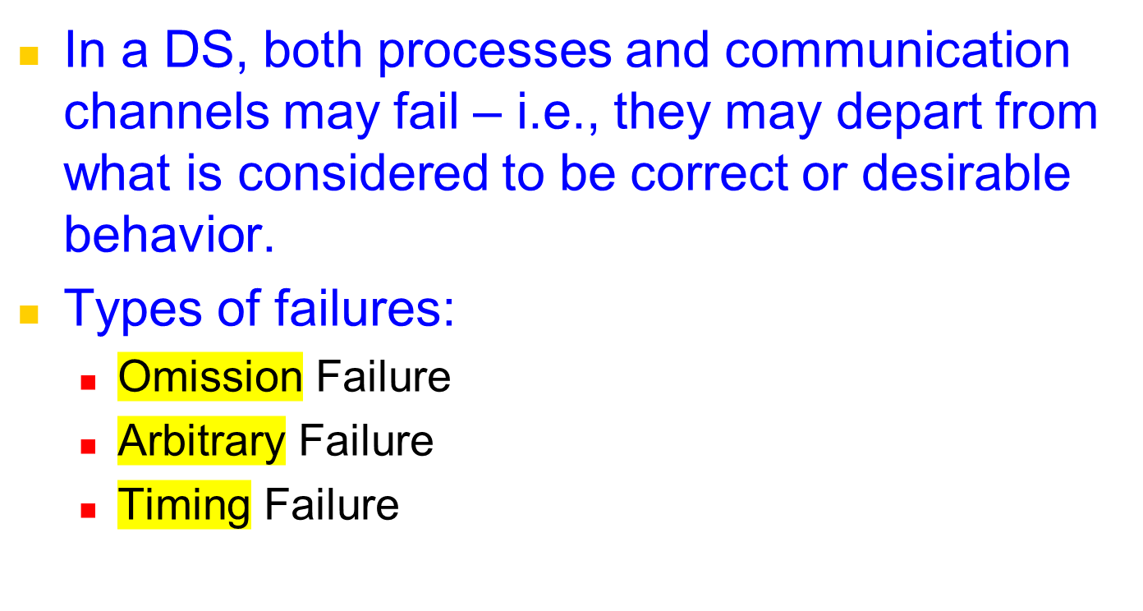
Failure Model
Notes:
Omission failure refer to cases where the process or communication channel fails to perform a requested action
Arbitrary failures are the most tricky to deal with, where any type of error can occur. Corrupt data, unexpected responses
Timing failures are related to synchronous messages, where a set bound [clock drift, message ack, process execution time] exceeds defined bounds

Slide 42
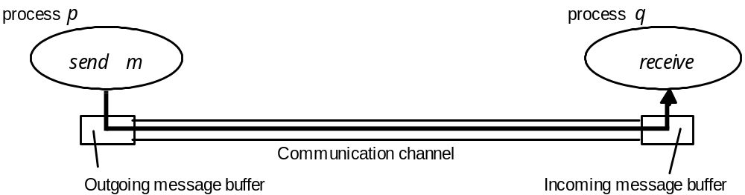
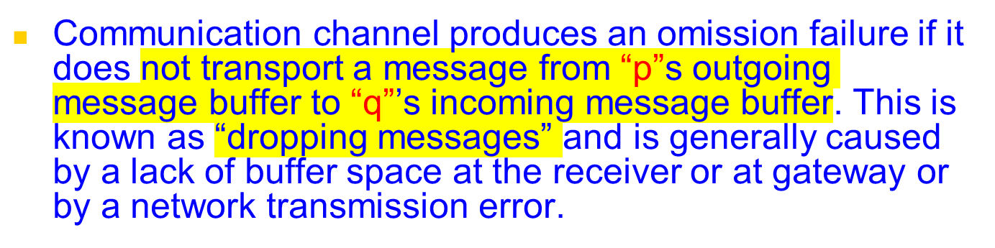
Processes and channels
Notes:
Here we see a omission failure which can occur for a number of reasons
Message is not accepted from process ‘s outgoing buffer onto the link
Message is accepted but does not reach q’s incoming buffer (e.g. router failure or overload, R.E.D, or link down)

Slide 43
Omission and arbitrary failures
Class of failure
Affects
Description
Fail-stop
Process halts and remains halted. Other processes may
Process
detect this state.
Crash
Process halts and remains halted. Other processes may
Process
not be able to detect this state.
Omission
A message inserted in an outgoing message buffer never
Channel
arrives at the other end’s incoming message buffer.
Send-omission
Process
A process completes a
send, but the message is not
put in its outgoing message buffer.
Receive-omission
Process
A message is put in a process’s incoming message
buffer, but that process does not receive it.
Arbitrary
Process or
Process/channel exhibits arbitrary behaviour: it may
(Byzantine)
send/transmit arbitrary messages at arbitrary times,
channel
commit omissions; a process may stop or take an
incorrect step.
Notes:
Fail-stop can be detected by the absence of the process on the server (e.g do a ps -A, task manager on windows)
Crash may be difficult to detect as process may still be running (zombie) but performing no useful function, ignoring messages
Omission - comms error
Send-omission - sent by process but does not make it to outgoing buffer (o/s or application error)
Receive-ommission - received by system but does not make it to process (application or middleware error)

Slide 44
Timing failures
Class of Failure
Affects
Description
Clock
Process
Process’s local clock exceeds the bounds on its
rate of drift from real time.
Performance
Process
Process exceeds the bounds on the interval
between two steps.
Performance
Channel
A message’s transmission takes longer than the
stated bound.
Notes:
Timing failures are most prevalent with synchronous systems with defined hard bounds on timing, performance and network characteristics
Bounds could be obtained by measuring actual system (e.g. measure 1000 runs so you know what “normal” behaviour is)

Slide 45
Masking Failures
It is possible to construct reliable services from components that exhibit failures.
  For example, multiple servers that hold replicas of data can continue to provide a service when one of them crashes.
A knowledge of failure characteristics of a component can enable a new service to be designed to mask the failure of the components on which it depends:
  Checksums are used to mask corrupted messages.
Notes:
We can add reliability through redundancy. Once system by itself may be unreliable but if we replicate it there is a very low probability of them all failing simultaneously
When dealing with unreliable networks we can mask the failures that can occur. E.g use TCP instead of UDP.
Use checksums and error-correcting codes to ensure data integrity. Add reliability at the application level.

Slide 46
Security Model
The security of a DS can be achieved by securing the processes and the channels used in their interactions and by protecting the objects that they encapsulate against unauthorized access.
Notes:
Two components: secure channel and secure process

Slide 47
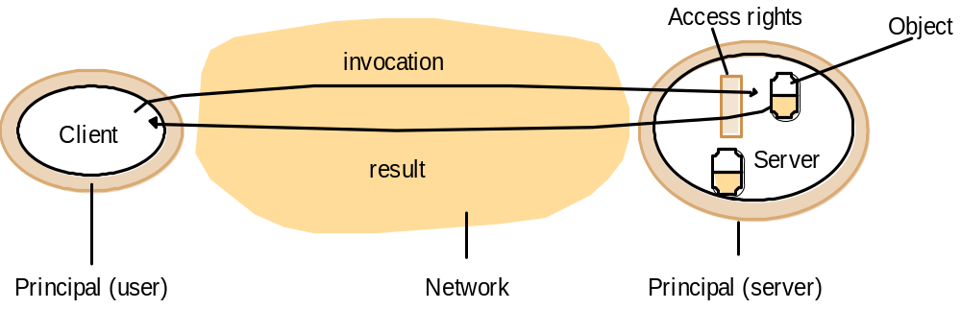
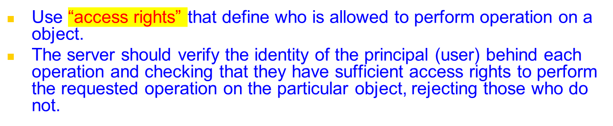
Protecting Objects: Objects and principals
Notes:
Modern O/S allow us to place restriction on who can access what services and resources at a given time.
A server can do likewise by checking access rights for requestors of service (e.g. via an A.C.L) to ensure they can use a particular service. Check credentials! If not satisfied, reject. We can place arbritrary restrictions, e.g. need user/pass and need to be located on a certain IP/subnet.

Slide 48
The enemy
Copy of
m
The enemy
m’
p
m
Process
q
Process
Communication channel
To model security threats, we postulate an enemy that is capable of sending any process or reading/copying message between a pair of processes
Threats form a potential enemy: threats to processes, threats to communication channels, and denial of service.
Notes:
Given we don’t control the end-to-end path our communication, we have to assume that an entity could capture our packets, copying them, resend them and masquerade as us. (show traceroute)
Threats can also come from seemingly legitimate access of our server process. Denial of service occurs when a large number of clients make concentrated legitimate requests on a server process or a particular link, with the intention of overloading it and making it crash

Slide 49
Defeating security threats: Secure channels
Principal
A
Principal
B
p
Process
Secure channel
Process
q
Encryption and authentication are use to build secure channels.
Each of the processes knows the identity of the principal on whose behalf the other process is executing and can check their access rights before performing an operation.
Notes:
Secure channels are essential for many modern distributed computing applications. We can use the untrusted internet with confidence to do shopping, online banking and share trading over public networks by using secure channels.
Most approaches use a public/private key pair system (e.g. SSH, HTTPS/SSL, VPN) where traffic is encrypted by the sender with their private key and decrypted and verified by the receiver using the senders public key. Combine this with Access rights!

Slide 50
Presentation Outline
Introduction
Architectural Models
  Software Layers
  System Architectures
    Client-Server
      Clients and a Single Sever, Multiple Servers, Proxy Servers with Caches, Peer Model
    Alternative Client-Sever models driven by:
      Mobile code, mobile agents, network computers, thin clients, mobile devices and spontaneous networking
    Design Challenges/Requirements
Fundamental Models – formal description
  Interaction, Failure, and Security models.
Summary

Slide 51
Summary
Most DSs are arranged accordingly to one of a variety of architectural models:
  Client-Server
    Clients and a Single Sever, Multiple Servers, Proxy Servers with Cache, Peer Model
  Alternative Client-Sever models driven by:
    Mobile code, mobile agents, network computers, thin clients, mobile devices and spontaneous networking
Fundamental Models – formal description
  Interaction, failure, and security models.
The concepts discussed in the module play an important role while architecting DS and apps.

